Slide 1
Introduction to SQL Joins

Slide 2
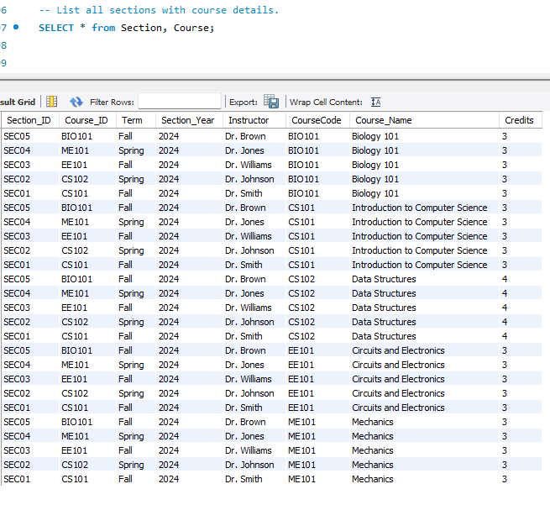
SELECT * FROM Section, Course effectively produce the same result, as both generate a Cartesian product of the Section and Course tables. This means every row in the Section table is combined with every row in the Course table.

Slide 3
Motivation: Why Do We Need Joins?
When working with relational databases, data is stored in multiple related tables to avoid redundancy.
For example, in our Registration database:
Section and Course tables store different but related information about courses and sections.
Listing all sections with course details requires combining data from these two tables. Issue with Cross Product (Cartesian Join):
If we run the query SELECT * FROM Section, Course;,
it produces a Cartesian Product:
Each row in Section is matched with each row in Course, resulting in a large number of rows, many of which are incorrect matches.
This leads to irrelevant and excessive data that is not useful for the intended purpose.
Solution: Using Joins allows us to specify relationships between tables and retrieve meaningful results.

Slide 4
2. What Are Joins?
Joins are used to retrieve data from multiple tables based on a related column between them.
Joins help us combine data efficiently without generating irrelevant combinations like the Cartesian product.
3. Types of Joins
Let's go through the main types of joins, using examples based on the Registration database.
a. Inner Join
Definition: Retrieves records that have matching values in both tables.
Example:
SELECT Section.Section_ID, Section.Term, Section.Section_Year, Section.Instructor,
Course.CourseCode, Course.Course_Name, Course.Credits
FROM Section
INNER JOIN Course ON Section.Course_ID = Course.CourseCode;

Slide 5
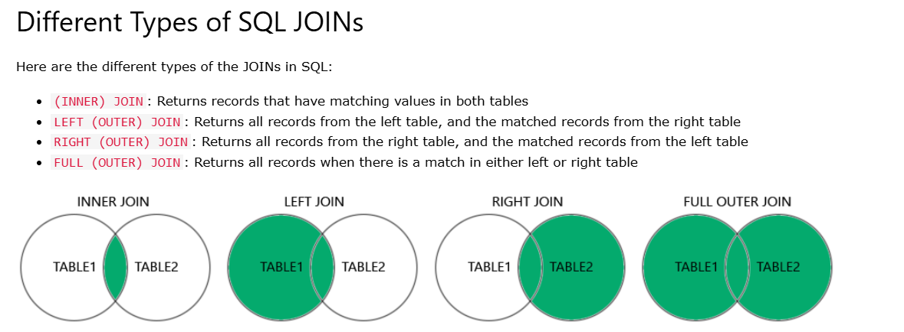

Slide 6
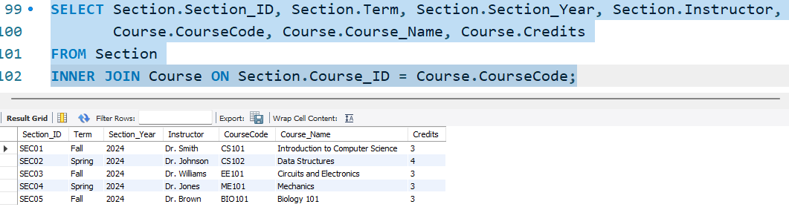
Explanation: This query only returned sections that have a matching course in the Course table.
Result:
Only rows with matching Course_ID in Section and CourseCode in Course are included.

Slide 7
b. Left Join (or Left Outer Join)
Definition: Retrieves all records from the left table (e.g., Section), and the matched records from the right table (Course). If there is no match, NULL values are returned for columns from the right table.
Example:
SELECT Section.Section_ID, Section.Term, Section.Section_Year, Section.Instructor,
Course.CourseCode, Course.Course_Name, Course.Credits
FROM Section
LEFT JOIN Course ON Section.Course_ID = Course.CourseCode;

Slide 8
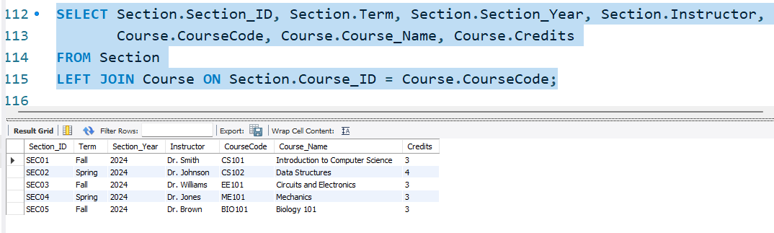
Explanation: This query will list all sections, even those that don’t have an associated course in the Course table.
Result:
For any section without a matching course, the Course fields will show NULL.

Slide 9
c. Right Join (or Right Outer Join)
Definition: Retrieves all records from the right table (Course), and the matched records from the left table (Section).
If there is no match, NULL values are returned for columns from the left table.

Slide 10
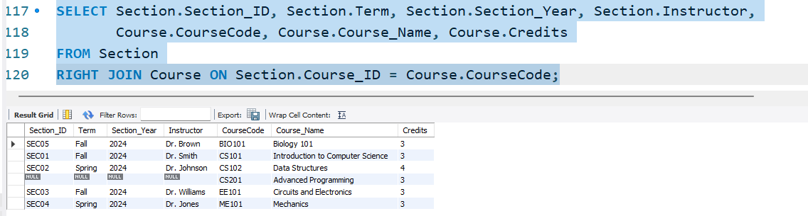
Explanation: This will show all courses, even if they don’t have a corresponding section.
Result:
For any course without a section, the Section fields will show NULL.

Slide 11
c. Full Outer JOIN
Definition: Combines the results of both left and right joins.
Returns all records when there is a match in either left or right table.
Rows without a match in the other table will show NULL for that table’s columns.
SELECT Section.Section_ID, Section.Term, Section.Section_Year, Section.Instructor, Course.CourseCode, Course.Course_Name, Course.CreditsFROM SectionFULL OUTER JOIN Course ON Section.Course_ID = Course.CourseCode;

Slide 12
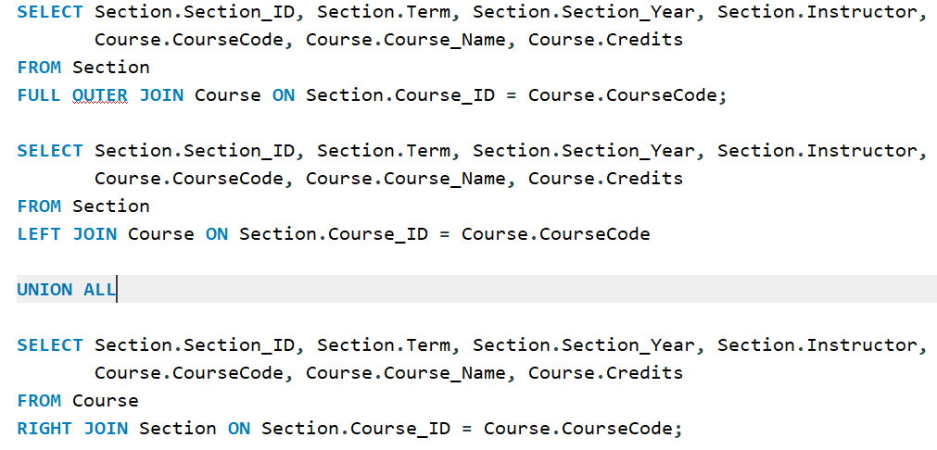
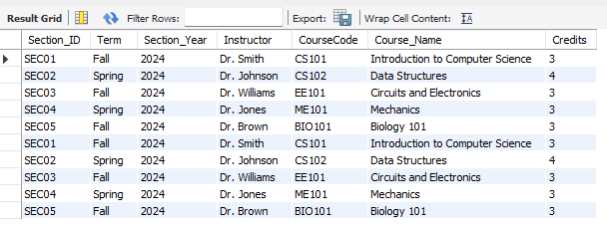

Slide 13
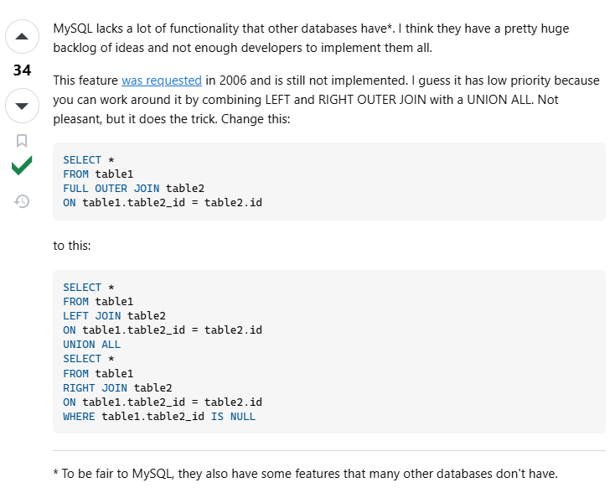
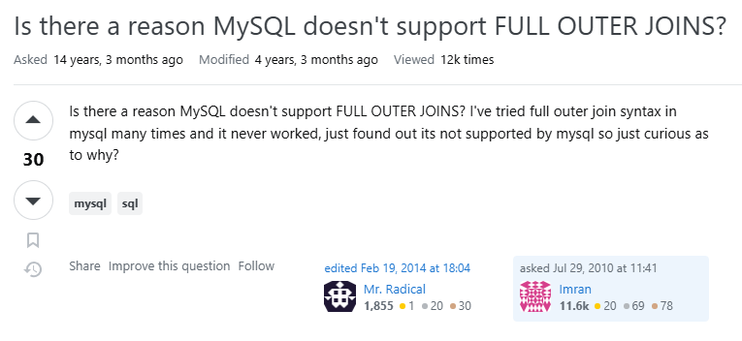

Slide 14
Cross Join
Definition: Produces a Cartesian product of two tables. Every row in the first table is combined with every row in the second table.
Explanation: The query produces all possible combinations of Section and Course rows. This is rarely useful except in specific cases, like generating test data.

Slide 15
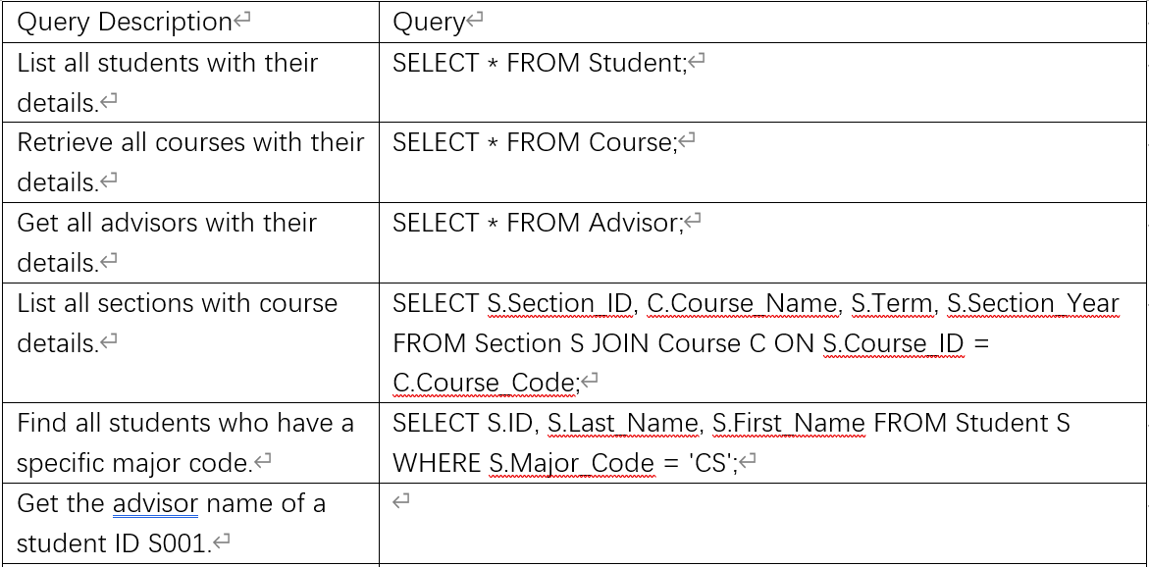

Slide 16
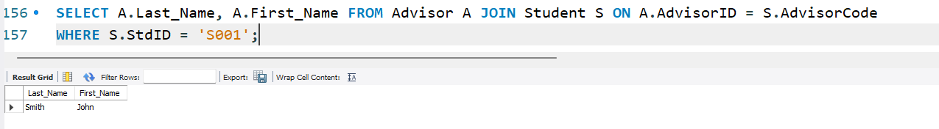
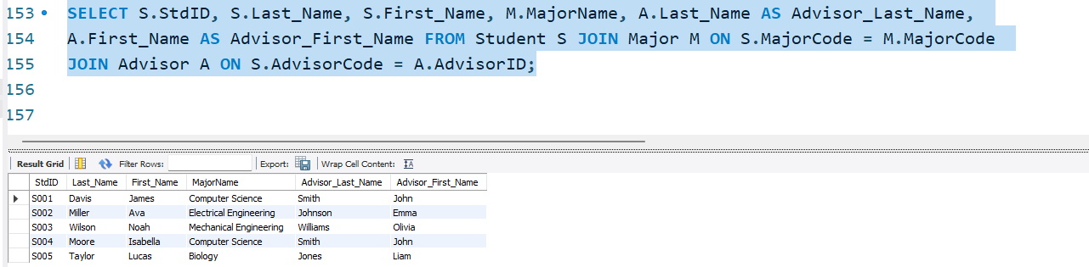
Get the advisor name of a student ID S001.
List all students with their major name and advisor name.

Slide 17
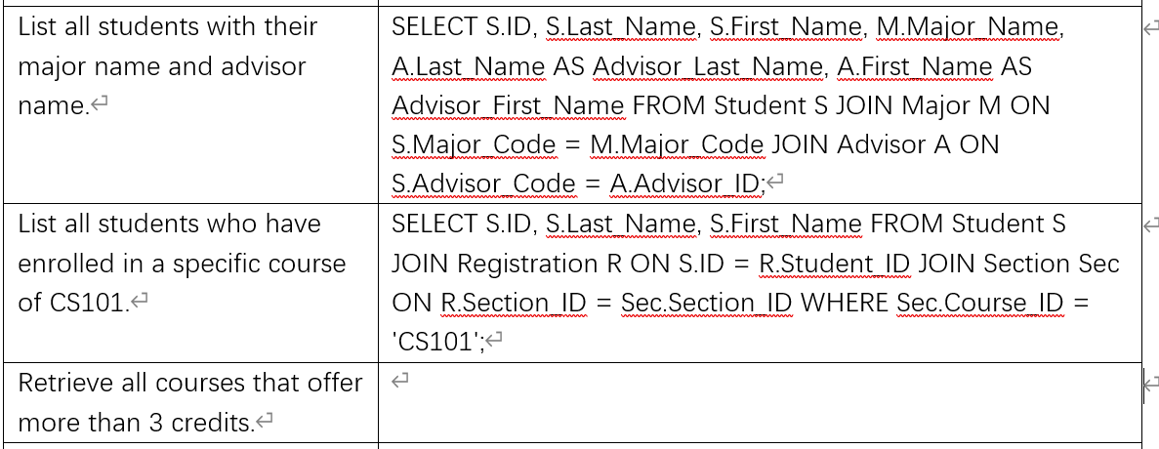

Slide 18
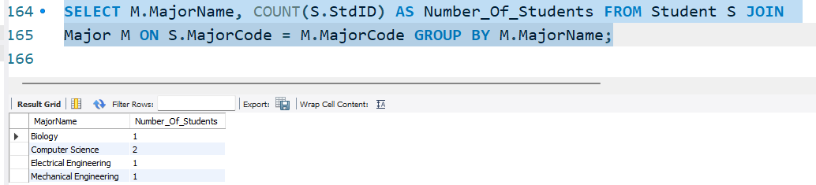
Count the number of students in each major.
Find students who have enrolled in Advance Programming

Slide 19
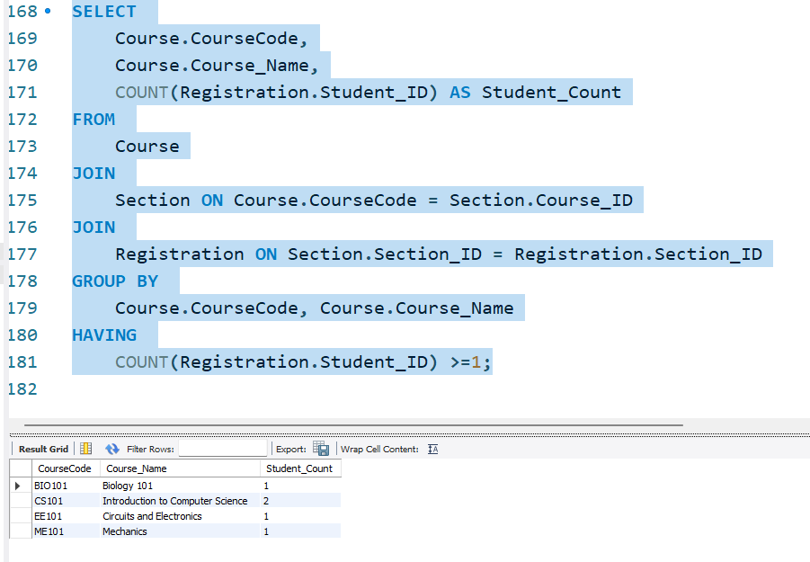
Find all courses that have more than 1 students enrolled.

Slide 20
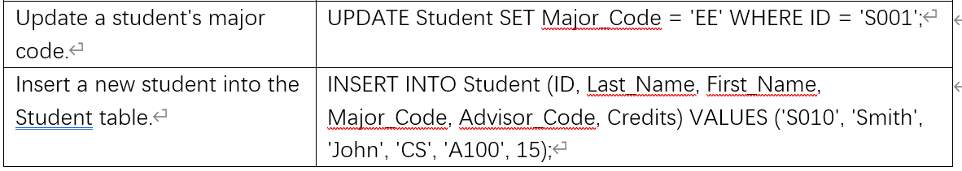
Delete a student record with ID 010., It should be deleted or it will raise error?

Slide 21
HOMEWORK
Find the total number of students enrolled in each course.
Find the section with the highest enrollment.
List all advisors and the number of students they advise.
Get the average grade for all students in a specific course.
List all courses and the total credits for each course.
List the students who have completed more than 30 credits.
Retrieve all students and their section details.
Find the courses that are taught by a specific instructor.

Slide 22
Get the list of students who are taking the same course.
Retrieve all students and their advisor’s first name.
List students who have received a grade higher than 'C'.
Find all students who have enrolled in a specific section.
Get the number of sections offered for each course.
Update the grade for all students in a specific section.

